Slide 1
Micro-Operation
Computer system micro-operations are of four types:
  Register transfer micro-operations
  Arithmetic micro-operations
  Logic micro-operations
  Shift micro-operations

Slide 2
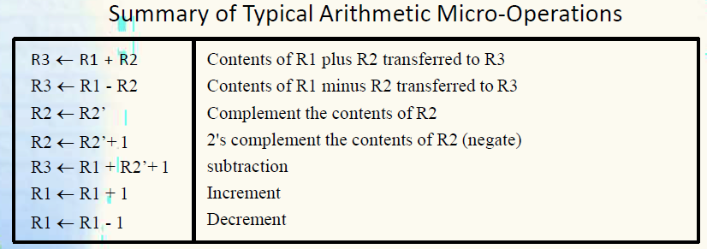
Arithmetic Micro-operations

Slide 3
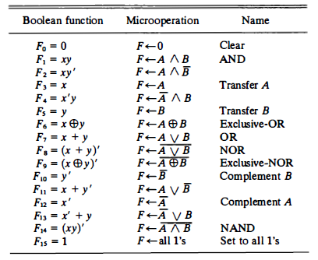
Logical Micro-operations

Slide 4
Shift Micro-operations
R ← shl R Shift-left register R
R ←shr R Shift-right register R
R ←cil R Circular shift-left register R
R ← cir R Circular shift-right register R
R ← ashl R Arithmetic shift-left R
R ← ashr R Arithmetic shift-right R

Slide 5
LOGICAL SHIFT
Shift Microoperations
In a logical shift the serial input to the shift is a 0.
A right logical shift operation:
A left logical shift operation:
In a Register Transfer Language, the following notation is used
  shl for a logical shift left
  shr for a logical shift right
0
0

Slide 6
CIRCULAR SHIFT
Shift Microoperations
In a circular shift the serial input is the bit that is shifted out of the other end of the register.
A right circular shift operation:
A left circular shift operation:
In a RTL, the following notation is used
  cil for a circular shift left
  cir for a circular shift right

Slide 7


Logical versus Arithmetic Shift
A logical shift fills the newly created bit position with zero:
An arithmetic shift fills the newly created bit position with a copy of the number’s sign bit:
Arithmetic Right Shift Process

Slide 8
ARITHMETIC SHIFT
Shift Microoperations
An left arithmetic shift operation must be checked for the overflow
0
sign
bit
V
Before the shift, if the leftmost two bits differ, the shift will result in an overflow
In a RTL, the following notation is used
  ashl for an arithmetic shift left
  ashr for an arithmetic shift right

Slide 9
APPLICATIONS OF LOGIC MICROOPERATIONS
Logic Microoperations
Logic micro-operations can be used to manipulate individual bits or a portions of a word in a register.
Consider the data in a register A. In another register B is bit data that will be used to modify the contents of A.

Slide 10
SELECTIVE SET
Logic Microoperations
In a selective set operation, the bit pattern in B is used to set certain bits in A.
1 1 0 0 A
1 0 1 0 B (A ← A + B) OR Operation
1 1 1 0 A

Slide 11
SELECTIVE COMPLEMENT
Logic Microoperations
In a selective complement operation, the bit pattern in B is used to complement certain bits in A.
1 1 0 0 A
1 0 1 0 B (A ← A ⊕ B) XOR Operation
0 1 1 0 A

Slide 12
SELECTIVE CLEAR
Logic Microoperations
In a selective clear operation, the bit pattern in B is used to clear certain bits in A.
1 1 0 0 A
1 0 1 0 B (A ← A ⋅ B’)
0 1 0 0 A

Slide 13
MASK OPERATION
Logic Microoperations
The mask operation is similar to selective-clear operation except that the bits of A are cleared only where there are corresponding 0’s in B.
1 1 0 0 A
1 0 1 0 B (A ← A ⋅ B) AND Operation
1 0 0 0 A

Slide 14
INSERT OPERATION
Logic Microoperations
An insert operation inserts a new value into a group of bits. This is done by first masking the bits and then ORing them with the required value.
Example: A register contains eight bits 0110 1010. To replace the four leftmost bits by the value 1001, we first mask the four unwanted bits.
    0110 1010 A before
    0000 1111 B (mask)
    0000 1010 A after masking AND Operation
    And then insert the new value
    0000 1010 A before
    1001 0000 B (insert)
    1001 1010 A after insertion OR Operation

Slide 15
Question
Register A holds the 8-bit binary 11011001. Determine the B operation and the logic microoperation to be performed in order to change the value in A to : 01101101, 11111101

